Slide 1
Otorowiri Model Update

Slide 2
Objectives
How can we best understand the occurrence of springs around the Otorowiri outcrop?
Are they simply a topography-controlled feature, and springs occur where the topography naturally cuts into the water table?
Or is there some kind of geological feature acting as a barrier to flow that promotes spring occurrence?

Slide 3
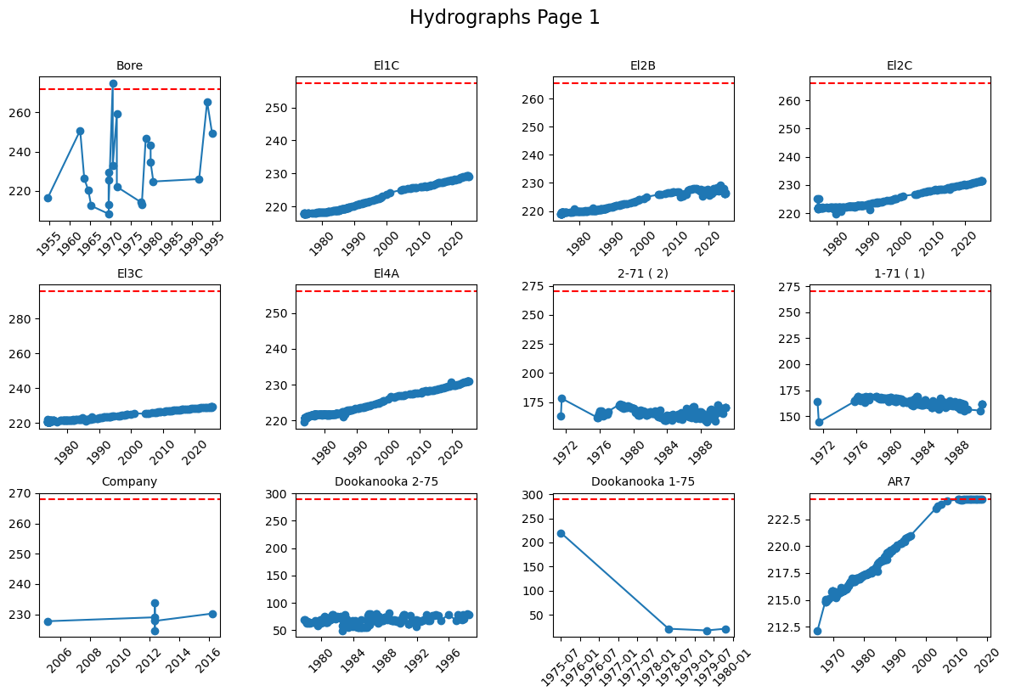
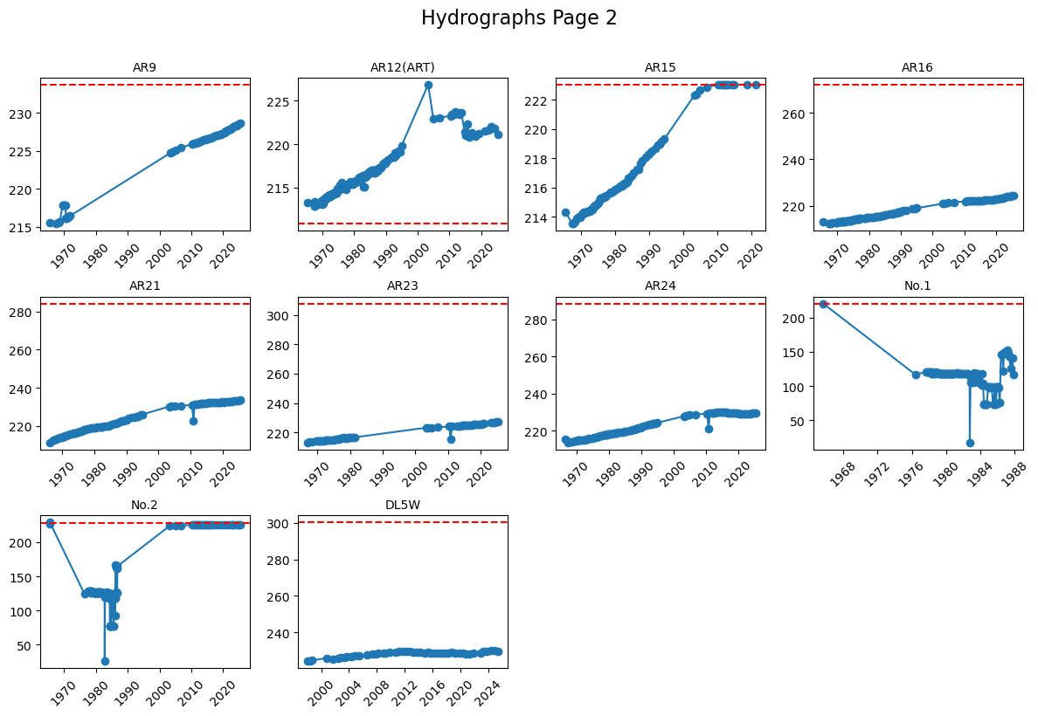
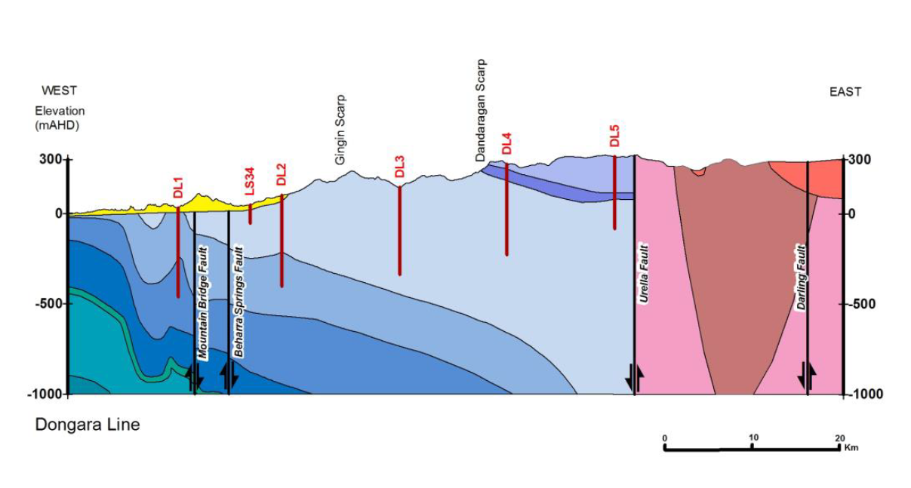
Inconsistencies with unconfined conceptualisation
Conceptualised as an unconfined aquifer, however, in addition to the springs there are artesian heads in some bores, both at the boundary and in the Parmelia aquifer

Slide 4
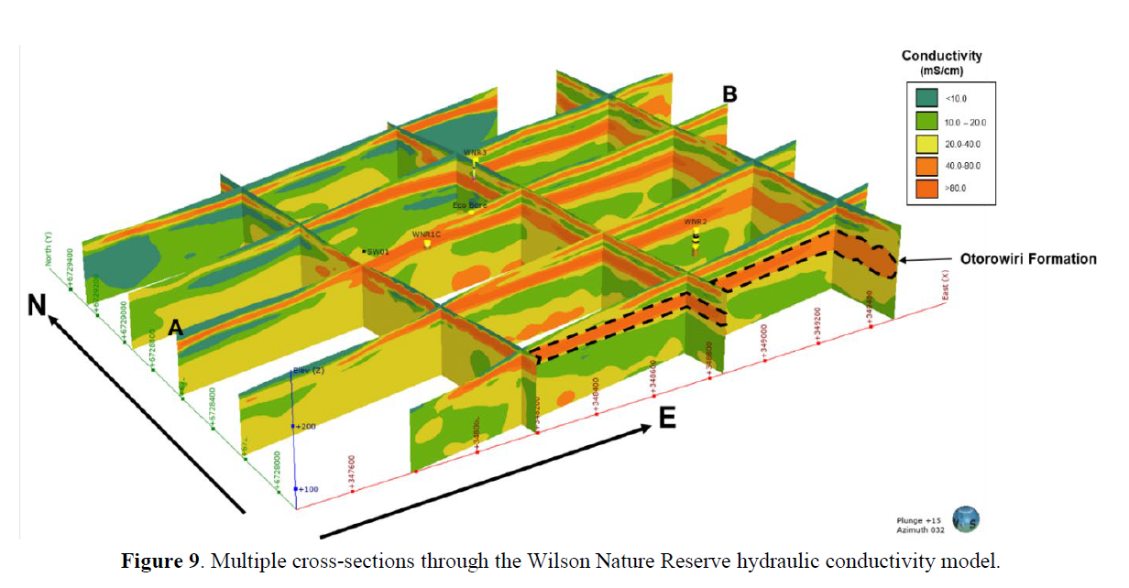
Question on multiple scales
Are there local-scale geological features that prompt the occurrence of springs close to the Otorowiri outcrop?

Slide 5
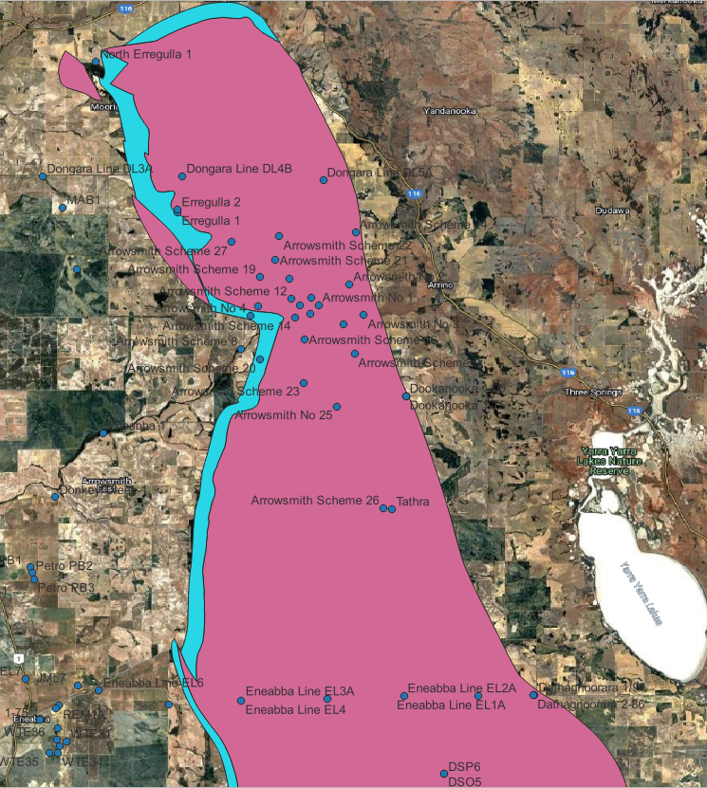
Question on multiple scales
Are there regional-scale geological features that create some level of confinement, which then causes artesian heads within the aquifer, and perhaps also influences spring occurrence?
If so, how do we characterise it with sparse boreholes information?

Slide 6
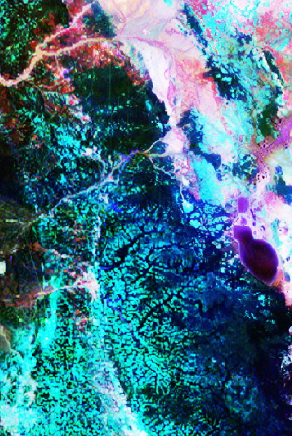
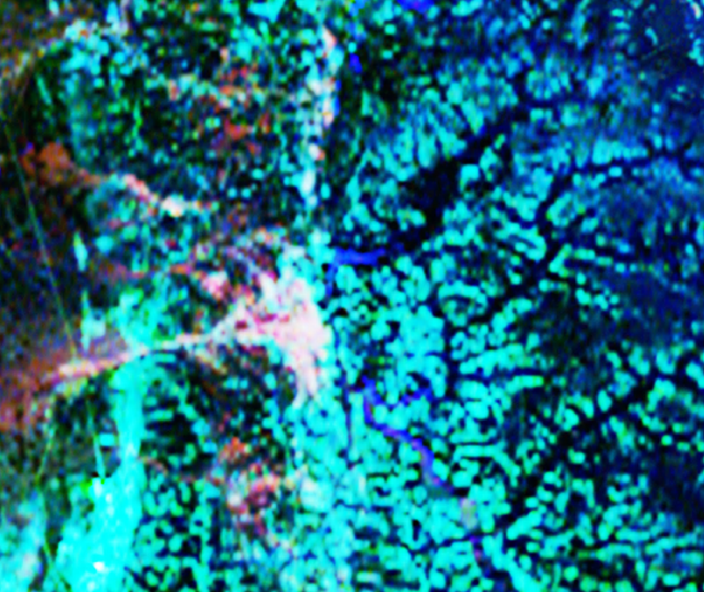
Possible solution: Radiometrics

Slide 7
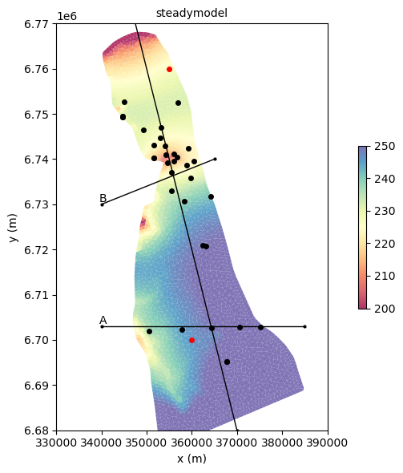
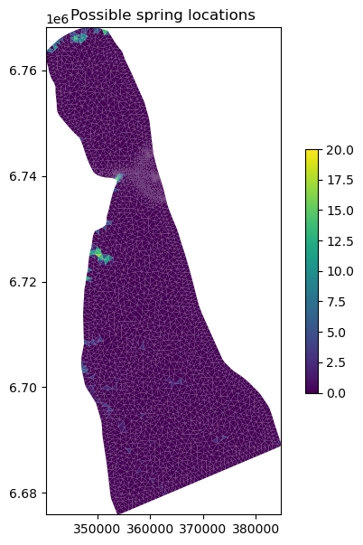
Steady state 3D simulation

Slide 8
Transient model objectives
If we can get decent history matching to better understand the occurrence of springs, we can then start forward modelling climate change scenarios with the vegetation, recharge (rainfall), and pumping

Slide 9
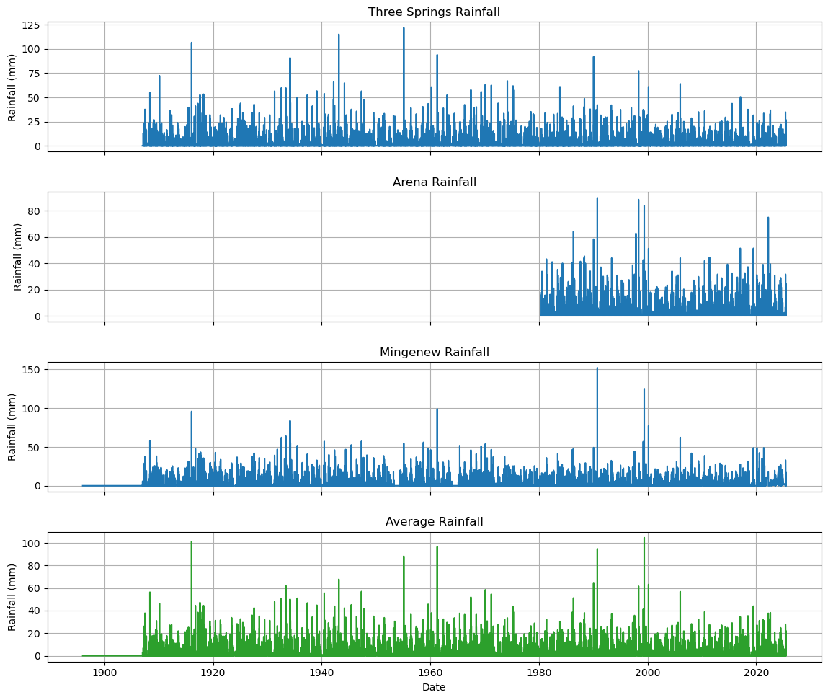
Preparations for transient model
Aiming for 148 stress periods → ‘Wet’ and ‘Dry’ periods for each year from 1950-2024
Allows for irregular timing of events and possible seasonal affects

Slide 10
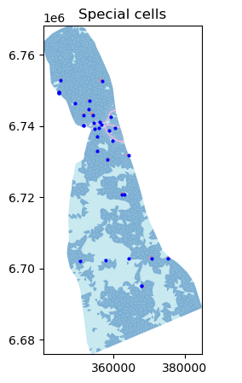
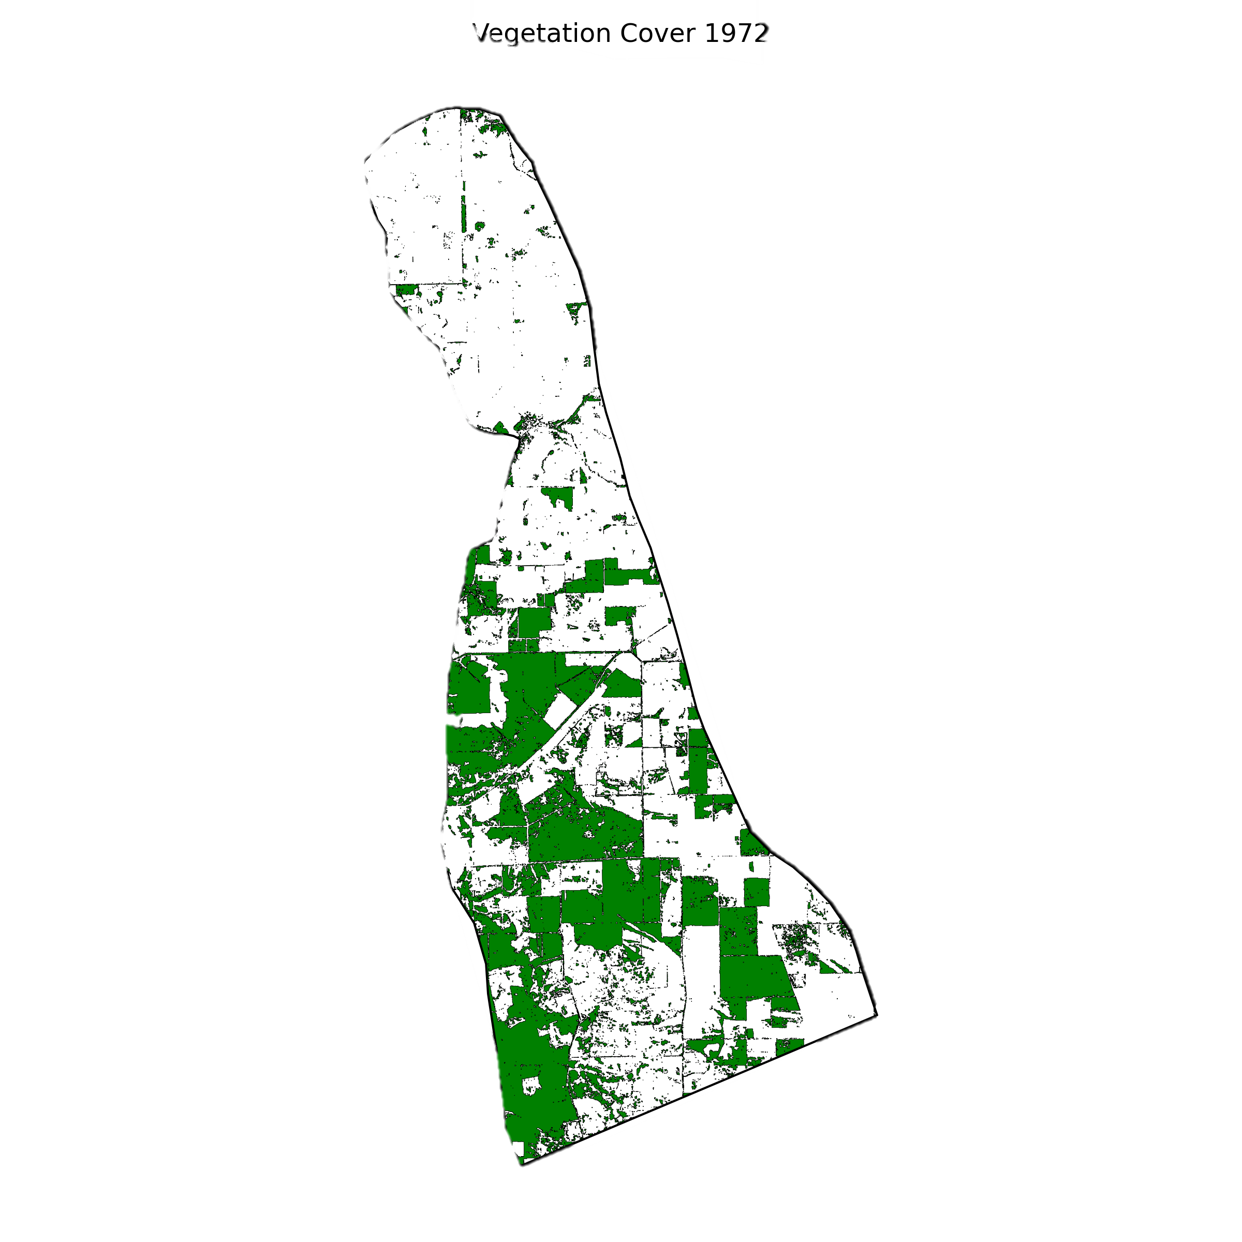
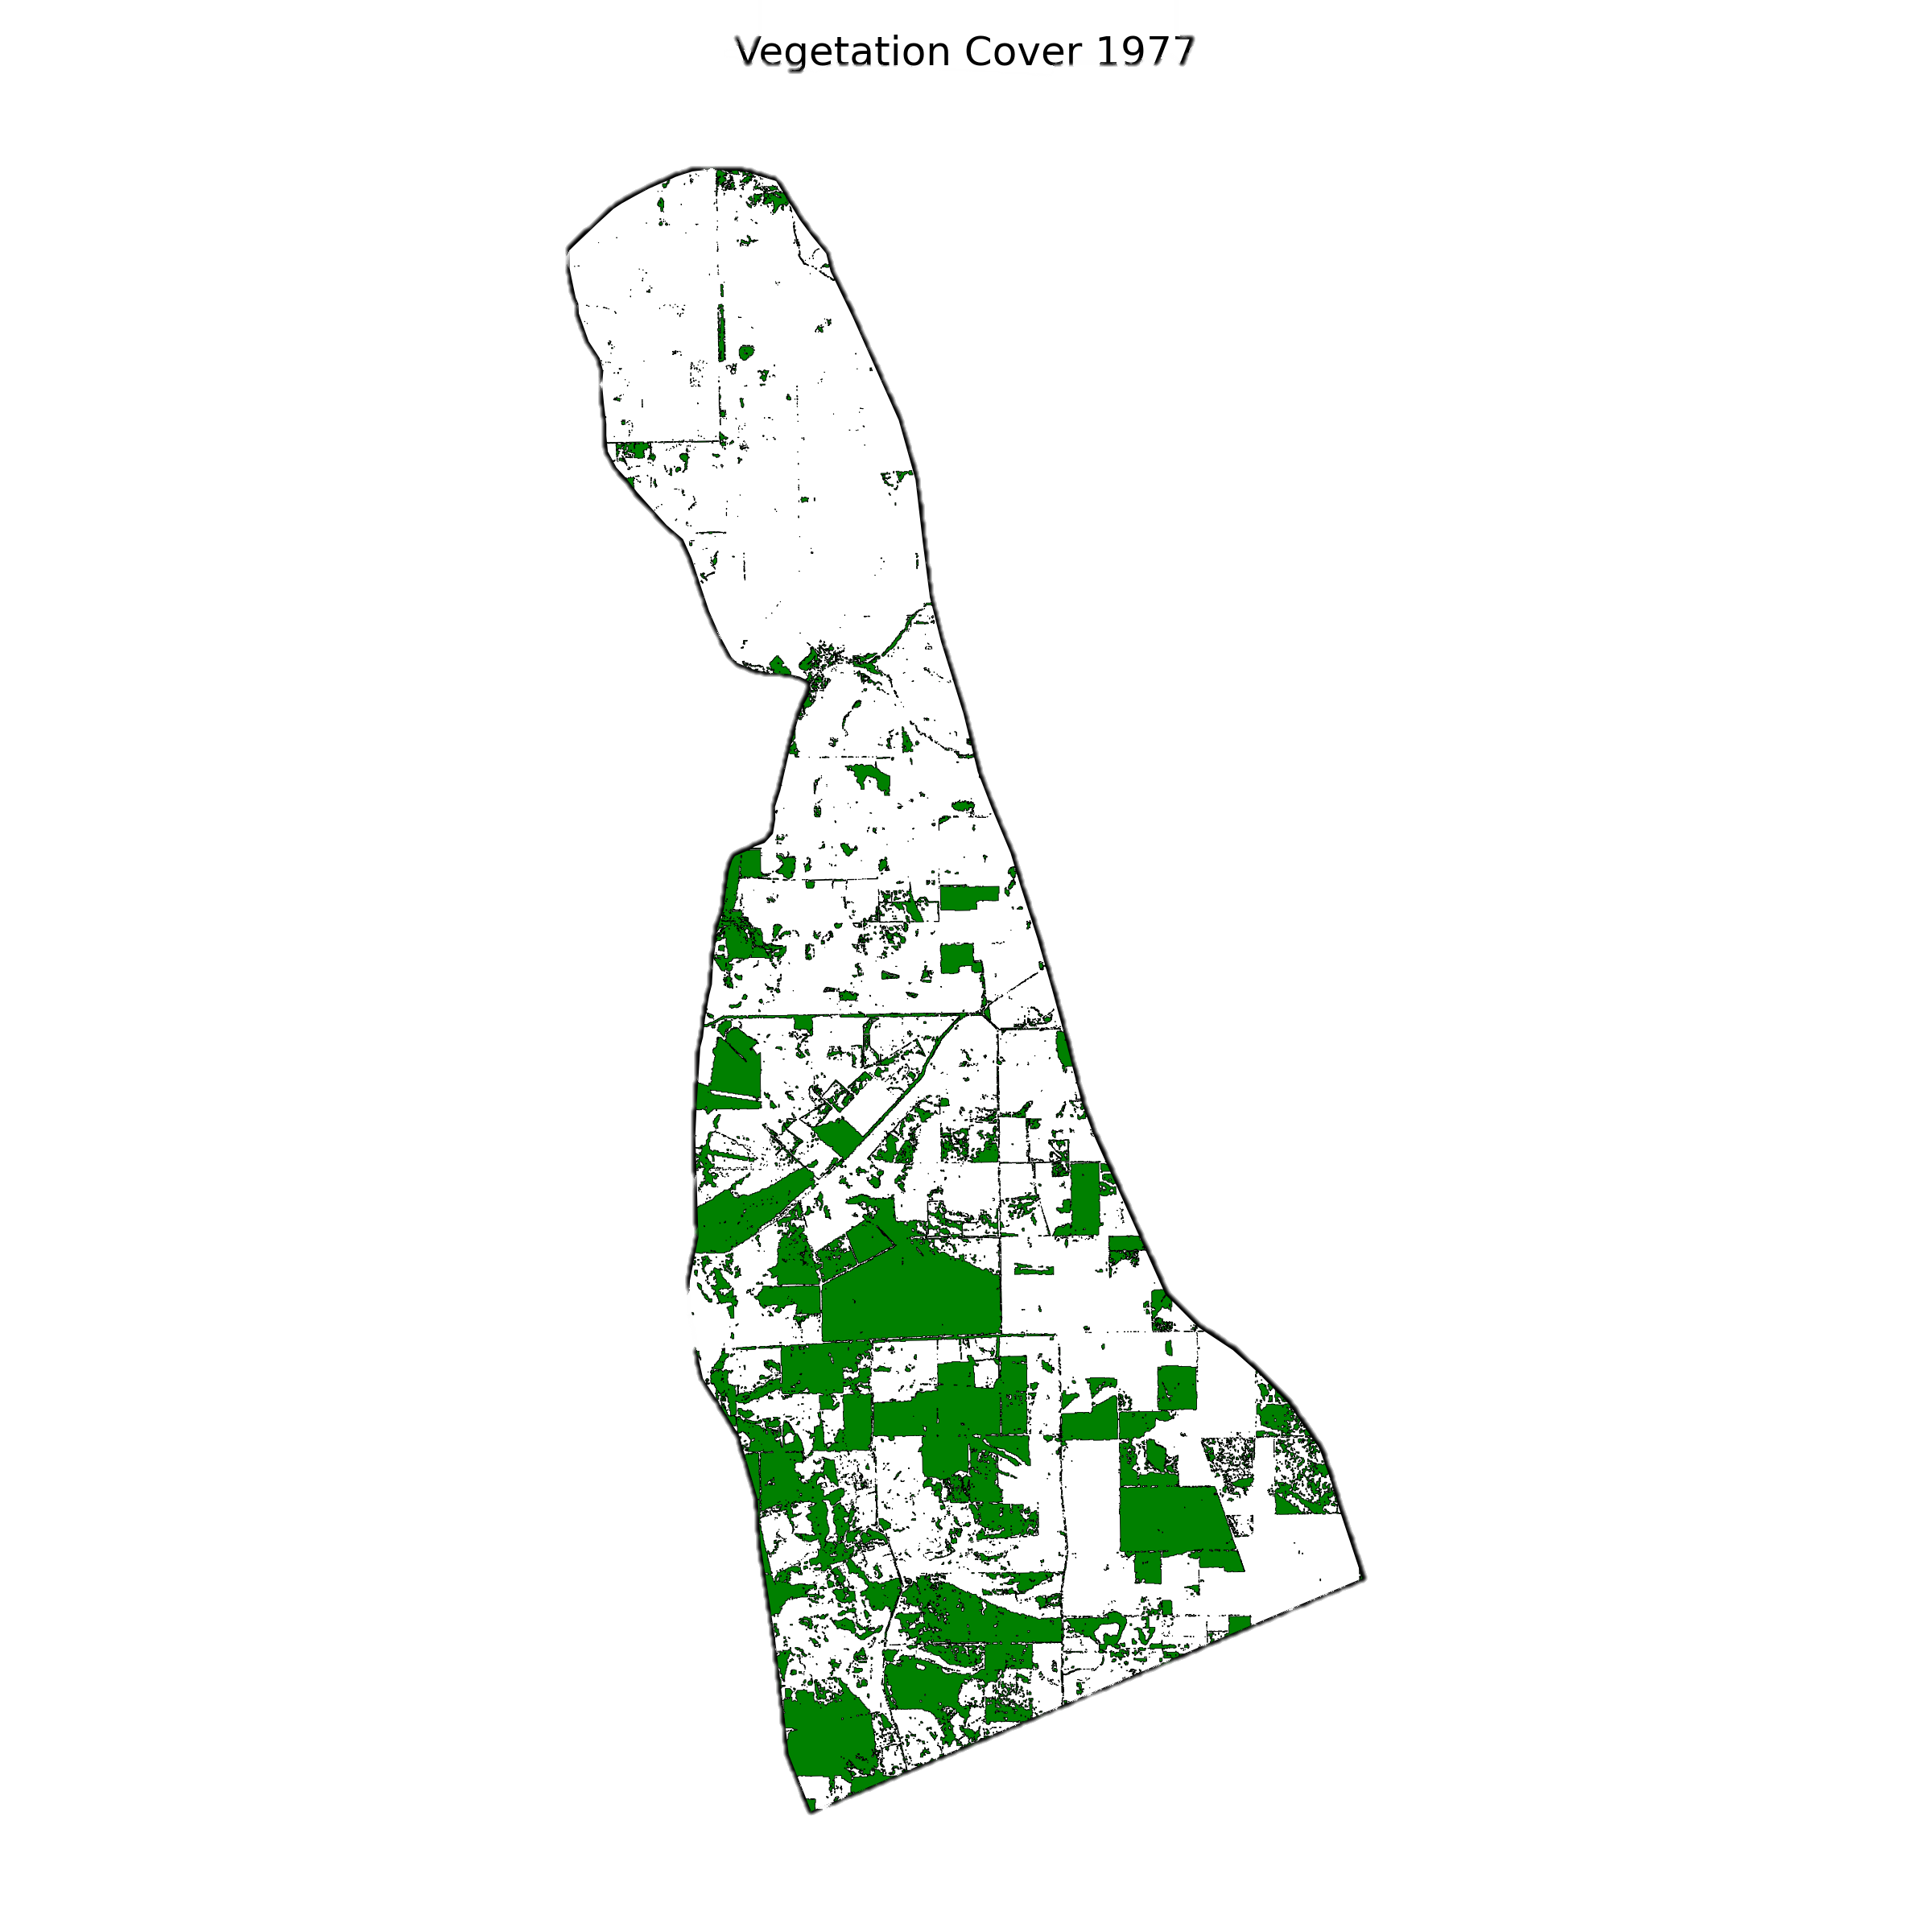
Vegetation change over time
1950 (pre-clearing)
95% native vegetation
Data available from 1972 - 2024
Control on
recharge and evapotranspiration
Random clearing throughout 1950s and 1960s

Slide 11
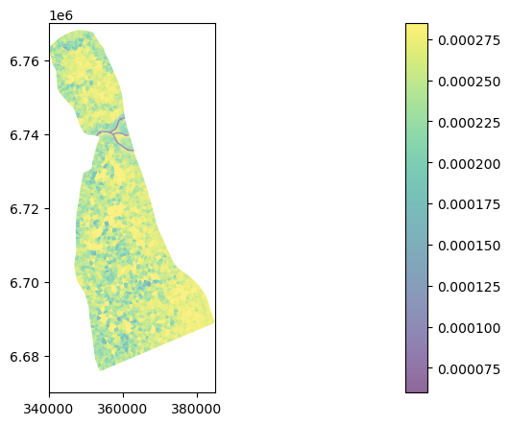
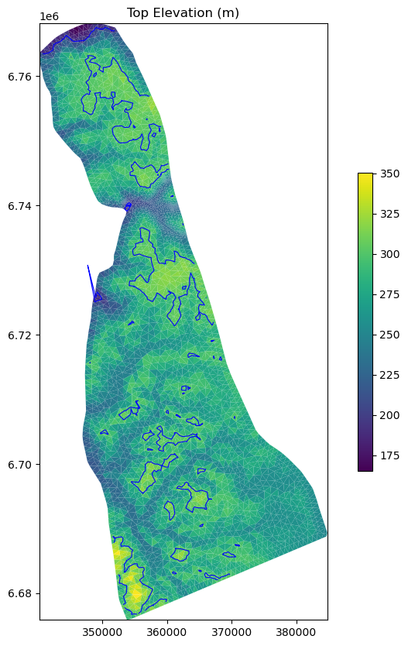
Recharge controlled by rainfall, veg and slope

Slide 12
Ongoing work for transient model
Missing piece of the puzzle → longest term pumping possible (using historic groundwater allocation data as approximation)
History matching the well information over time
PEST → uncertainty around many of the model parameters

